Slide 1
Characteristics of transistor

Slide 2
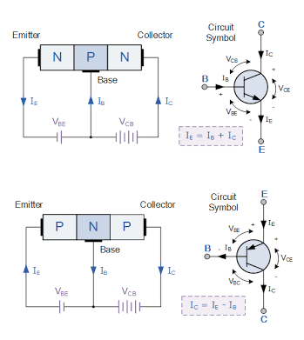
The transistor is a three terminal device and consists of three distinct layers.
Two of them are doped to give one type of semiconductor and the there is the opposite type,
i.e. two may be n-type and one p-type, or
two may be p-type and one may be n-type..
They are arranged so that the two similar layers of the transistor sandwich the layer of the opposite type.
As a result these semiconductor devices are designated as either PNP transistors or NPN transistors according to the way they are made up.

Slide 3
Transistor Characteristics
Transistor Characteristics are the plots which represent the relationships between the current and the voltages of a transistor in a particular configuration.
By considering the transistor configuration circuits to be analogous to two-port networks, they can be analyzed using the characteristic-curves which can be of the following types
Input Characteristics: These describe the changes in input current with the variation in the values of input voltage keeping the output voltage constant.
Output Characteristics: This is a plot of output current versus output voltage with constant input current.
Current Transfer Characteristics: This characteristic curve shows the variation of output current in accordance with the input current, keeping output voltage constant.

Slide 4
Common Base (CB) Configuration of Transistor
Common Collector (CC) Configuration of Transistor
Common Emitter (CE) Configuration of Transistor

Slide 5
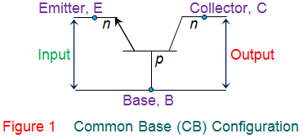
Common Base (CB) Configuration of Transistor
In CB Configuration, the base terminal of the transistor will be common between the input and the output terminals as shown by Figure 1. This configuration offers low input impedance, high output impedance, high resistance gain and high voltage gain.

Slide 6
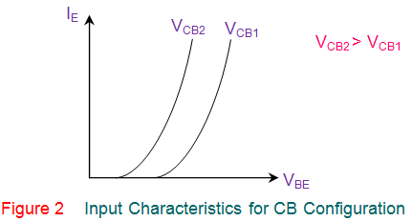
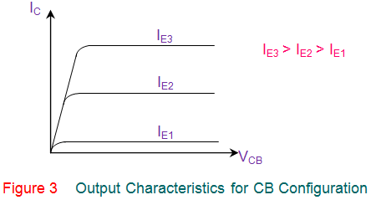
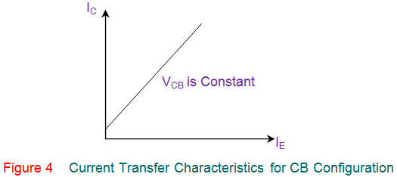

Slide 7
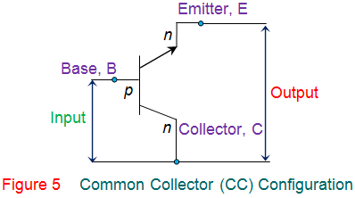
Common Collector (CC) Configuration of Transistor
This transistor configuration has the collector terminal of the transistor common between the input and the output terminals (Figure 5) and is also referred to as emitter follower configuration. This offers high input impedance, low output impedance, voltage gain less than one and a large current gain.

Slide 8
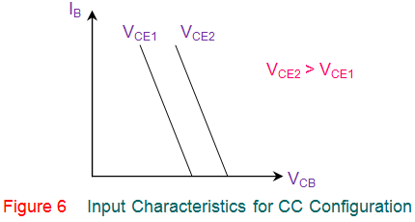
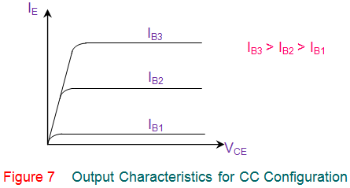
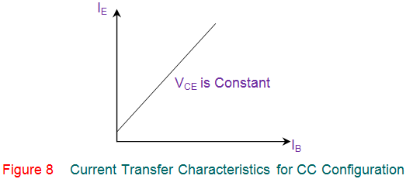

Slide 9
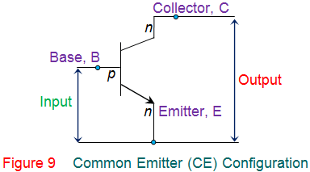
Common Emitter (CE) Configuration of Transistor
In this configuration, the emitter terminal is common between the input and the output terminals as shown by Figure 9. This configuration offers medium input impedance, medium output impedance, medium current gain and voltage gain.

Slide 10
